Slide 1
DESIGN AND SIMULATION OF ADDER AND SUBTRACTOR USING LOGISIM
COMBINATIONAL LOGIC AND ARITHMETIC CIRCUITS

Slide 2
COMBINATIONAL LOGIC
A combinational circuit produces output based only on its current inputs.
It does not store previous inputs.
It does not require memory elements.
Examples include:
  Adders
  Subtractors
  Multiplexers
  Decoders
  Comparators
Combinational circuits form important building blocks of a CPU.

Slide 3
K-MAP SIMPLIFICATION
K-map is used to simplify Boolean expressions.
It reduces the number of logic gates required.
Simplified circuits can be:
  Faster
  Smaller
  Lower power
  Less expensive
K-maps are useful in designing optimized combinational circuits.

Slide 4
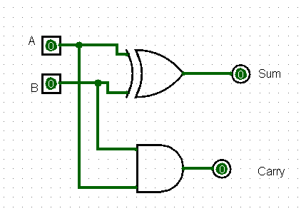
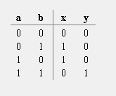
HALF ADDER
A Half Adder adds two 1-bit binary numbers.
Inputs: A, B
Outputs: Sum, Carry
Logic equations:
  Sum = A ⊕ B
  Carry = A · B
It does not have a Carry-in input.

Slide 5
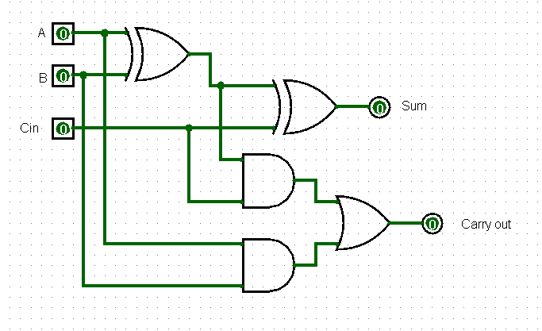
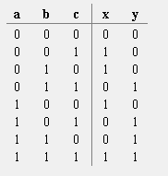
FULL ADDER
A Full Adder adds three 1-bit inputs.
Inputs: A, B, Cin
Outputs: Sum, Cout
It can be constructed using:
  Two Half Adders
  One OR gate
Logic Equations
Sum = A ⊕ B ⊕ Cin
Cout = AB + Cin(A ⊕ B)

Slide 6
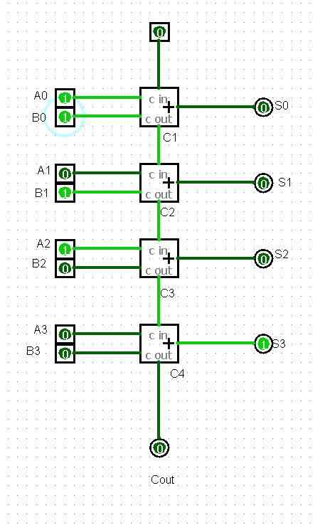
4-BIT RIPPLE-CARRY ADDER
A 4-bit Ripple-Carry Adder uses four Full Adders.
Each Full Adder handles one bit.
The carry output of one stage becomes the carry input of the next stage.
The carry propagates from the least significant bit to the most significant bit.
This propagation causes a delay in larger adders.

Slide 7
BINARY SUBTRACTION
Subtraction Using Two's Complement
Binary subtraction can be performed using an adder.
Two's complement is used to represent the negative value.
To obtain the two's complement:
  Invert all bits.
  Add 1.
Formula
A − B = A + (Two's Complement of B)
Example
0101 − 0011
Two's complement of 0011:
1101
Therefore:
0101 + 1101 = 0010
(discarding the final carry)

Slide 8
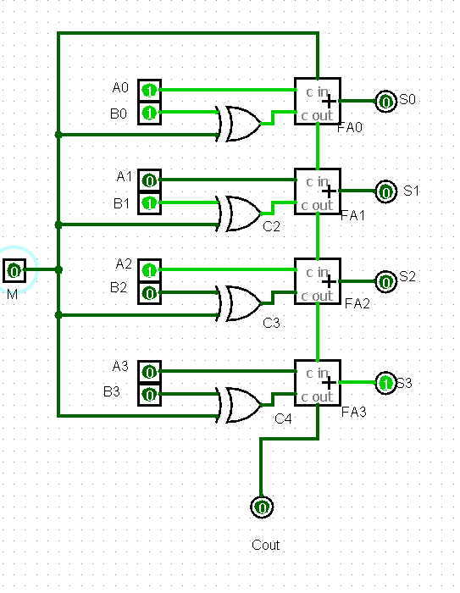
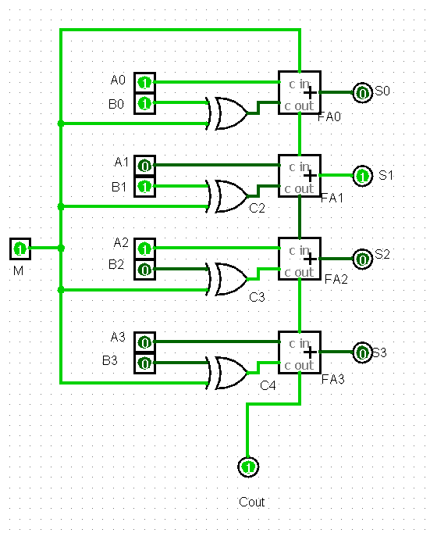
4-BIT ADDER-SUBTRACTOR
The same circuit can perform both addition and subtraction.
XOR gates are placed before the B inputs.
A control input M selects the operation.
Working
M = 0:
B remains unchanged and Cin = 0.
M = 1:
B is complemented and Cin = 1.
Therefore:
A + B' + 1 = A − B
M | Operation
0 | A + B
1 | A − B

Slide 9
ADDER SUBTRACTOR SIMULATION

Slide 10
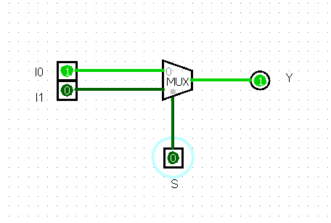
MULTIPLEXER
Multiplexer (MUX)
A Multiplexer is a data selector.
It selects one input from multiple inputs.
A 2:1 MUX has:
  2 data inputs: I0, I1
  1 select input: S
  1 output: Y

Slide 11
DECODER & COMPARATOR
Decoder
A decoder converts binary input into one of several output lines.
For n input lines, it can have up to 2ⁿ outputs.
Used in:
  Instruction decoding
  Memory selection
  Control circuits
Comparator
A comparator compares two binary numbers.
It determines whether:
  A > B
  A = B
  A < B
Comparators are useful for making decisions and supporting branch operations in CPUs.

Slide 12
Arithmetic Logic Unit (ALU)
The ALU is the part of the CPU that performs arithmetic and logical operations.
It can perform operations such as:
Addition
Subtraction
AND
OR
Comparison

Slide 13


